Slide 1
CAROLINA COLLABORATIVE FOR ALTERNATIVE PREPARATION (CarolinaCAP)
AN INNOVATIVE MODEL FOR COLLABORATION IN TEACHER PREPARATION
carolinacap.org

Slide 2
A DIFFERENT KIND OF COLLABORATION
Partnering SC School Districts
carolinacap.org

Slide 3
SOUTH CAROLINA SCHOOL DISTRICTS
South Carolina School districts bring expertise in the following areas (among others):
Strong understanding of the unique needs of the district, including knowledge of local context and expertise in teaching that should be drawn upon.
Knowledge of common shortcomings and unique needs among novice teachers in the district;
Keen understanding of staffing needs within the district; and
Ability to identify potential individuals to invest in as beginning teachers.
Partnering with school districts in co-constructing the CarolinaCAP model ensures the work will be directly informed and improved by field-based experiences and contexts.
carolinacap.org

Slide 4
COLLEGE OF EDUCATION @UNIVERSITY OF SOUTH CAROLINA
The College of Education is the largest preparer of teachers in South Carolina, combining a commitment to prepare teachers with research and service via the most robust Professional Development Schools (PDS) network in the nation.
The College of Education is uniquely positioned by way of the following:
Expertise in teacher preparation and development with a rich history of engagement and partnership with school districts;
Capacity to design and deliver high quality learning experiences for teacher candidates, leveraging a combination of coursework and classroom-embedded competencies; and
Strong and developing model for coaching novice teachers via Carolina Teacher Induction Program (CarolinaTIP).
carolinacap.org

Slide 5
Mira Education
Mira Education has led efforts across the nation to improve student learning by spurring innovation in teacher development and leadership.
Mira brings expertise in the following areas:
Developing systems of personalized, competency-based professional learning for teachers and administrators through micro-credentials.
Building virtual learning communities to spread pedagogical expertise in a “just-in-time” system of coaching and mentoring;
Assisting educators in measuring impact and telling public stories of their practice and leadership; and
Supporting system leaders in the redesign of teaching and teacher education policy.
carolinacap.org

Slide 6
ONE GOAL OF CarolinaCAP
Create a high-quality alternative pathway into teaching that marries the expertise of local teachers, schools, and districts with non-profits, ed tech companies, and institutions of higher education
carolinacap.org

Slide 7
PROGRAM COMPONENTS

Slide 8
PROGRAM DESIGN
A non-degree program of experiences to achieve goal of full licensure for candidates
A combination of graduate coursework, micro-credential stacks, and coaching, tailored to the needs of individuals
Candidates complete a launch experience of preparation and support prior to entering classrooms as teachers of record
carolinacap.org

Slide 9
PROGRAM DESIGN (CONT’D)
During the academic year and while teachers of record, candidates complete micro-credentials focusing on core pedagogical competencies and content area specific teacher knowledge, and expertise (based on assessed needs).
Candidates receive coaching via district-identified coach, coaches trained via CarolinaCAP Coaching (with tailored supports for alt cert coaching experience).
CarolinaCAP Coaches (practicing, accomplished teachers) receive coaching and support throughout the program to develop their coaching skills as co-teachers and their leadership skills to further impact the learning of both educators and their students.
carolinacap.org

Slide 10
Micro-credentials Aligned to SCTS 4.0 Rubric
Instruction
Selecting Materials
Planning
Planning lessons with the 5 E's
Understanding co-teaching
Environment
Introduction to PBIS
Planning for Questions
Asking Questions
Academic Feedback
One Teach, One Assist
Teaming
Check-in/Check-out
Self-monitoring
Teaching a Routine or Procedure
Professionalism
Reflecting on Teaching
Community Involvement
Growing and Developing Professionally
School Responsibilities
carolinacap.org

Slide 11
Micro-credentials in Development
Certification Areas
Diversity Equity and Inclusion
Read to Succeed
carolinacap.org

Slide 12
AREAS OF CERTIFICATION
Early Childhood Education
Elementary Education
Middle Level Science
Middle Level Mathematics
Secondary Biology
Secondary Chemistry
Secondary Mathematics
Secondary Physics
Special Education: Multi-categorical (PK–Grade 12)
carolinacap.org

Slide 13
Certification | Description of Academic Requirement
Middle Level Science | Degree in biology, chemistry, physics, or closely related field minimum of 6 hrs of biology, 3 hrs of chemistry, and 3 hrs of physics from a regionally accredited university Minimum 2.5 undergraduate GPA Passing scores on the SC required Praxis Subject Area Assessment for middle level science
Middle Level Mathematics | Degree in mathematics, engineering, statistics, or closely related field with a minimum of 18 hrs of mathematics coursework including a calculus sequence from a regionally accredited university Minimum 2.5 undergraduate GPA Passing scores on the SC required Praxis Subject Area Assessment for middle level mathematics
Individuals who have previously enrolled in student teaching or another alternative certification program are ineligible for CarolinaCAP.
carolinacap.org

Slide 14
Certification | Description of Academic Requirement
Secondary Biology | Degree in biology, biomedical engineering, biomechanical engineering, biochemical engineering, or closely related field with a minimum of 18 hrs of biology coursework from a regionally accredited university Minimum 2.5 undergraduate GPA Passing scores on the SC required Praxis Subject Area Assessment for secondary biology
Secondary Chemistry | Degree in chemistry, chemical engineering, biochemical engineering, or closely related field with a minimum of 18 hrs of chemistry coursework from a regionally accredited university Minimum 2.5 undergraduate GPA Passing scores on the SC required Praxis Subject Area Assessment for secondary chemistry
Individuals who have previously enrolled in student teaching or another alternative certification program are ineligible for CarolinaCAP.
carolinacap.org

Slide 15
Certification | Description of Academic Requirement
Secondary Physics | Degree in physics, civil engineering, mechanical engineering, or closely related field with a minimum of 18 hrs of physics coursework from a regionally accredited university Minimum 2.5 undergraduate GPA Passing scores on the SC required Praxis Subject Area Assessment for secondary physics
Secondary Math | Degree in mathematics, engineering, statistics, or closely related field with a minimum of 18 hrs of mathematics coursework including a calculus sequence from a regionally accredited university Minimum 2.5 undergraduate GPA Passing scores on the SC required Praxis Subject Area Assessment for secondary mathematics
Individuals who have previously enrolled in student teaching or another alternative certification program are ineligible for CarolinaCAP.
carolinacap.org

Slide 16
Certification | Description of Academic Requirement
Early Childhood Education | Bachelor’s degree from a regionally accredited institution. Minimum 2.75 undergraduate GPA. Applicants not meeting the 2.75 requirements will be considered for admission with a minimum 2.5 undergraduate GPA and passing scores on the three parts (reading, writing, and mathematics) of the Praxis Core Academic Skills for Educators. Passing scores on the SC required Praxis Subject Area Assessment for early childhood education
Elementary Education | Bachelor’s degree from a regionally accredited institution. Minimum 2.75 undergraduate GPA. Applicants not meeting the 2.75 requirements will be considered for admission with a minimum 2.5 undergraduate GPA and passing scores on the three parts (reading, writing, and mathematics) of the Praxis Core Academic Skills for Educators. Passing scores on the SC required Praxis Subject Area Assessment for elementary education
Individuals who have previously enrolled in student teaching or another alternative certification program are ineligible for CarolinaCAP.
carolinacap.org

Slide 17
Certification | Description of Academic Requirement
Special Education: Multi-categorical (PK–Grade 12) | Bachelor’s degree from a regionally accredited institution Minimum 2.75 undergraduate GPA Applicants not meeting the 2.75 requirement will be considered for admission with a minimum 2.5 undergraduate GPA and passing scores on the three parts (reading, writing, and mathematics) of the Praxis Core Academic Skills for Educators. Passing score on ETS Praxis II Special Education Multi-categorical Subject Assessment - Special Education: Core Knowledge and Mild-to-Moderate Applications
Individuals who have previously enrolled in student teaching or another alternative certification program are ineligible for CarolinaCAP.
carolinacap.org

Slide 18
AREAS OF COMPETENCY, SIX HOURS OF GRAD CREDIT
Courses developed and taught by University of South Carolina Faculty.
EDTE 600 - Systematic Effective Teaching focuses on the classroom environment, instruction, and professionalism. This course familiarizes students with relevant research, as well as provides students with opportunities to investigate theoretical perspectives, issues, and dispositions regarding classroom environment, instruction, and professionalism.
EDUC 632 – Inquiry into Teaching: A Study of Effective Practice is designed to engage students in guided inquiry focused on common problems of practice encountered in Pre-K-12 classrooms. Emphasis is on enhancing students’ knowledge of content and pedagogy, which impact learning. The content of the course familiarizes students with relevant research, as well as provides students with opportunities to systematically inquire into theoretical perspectives, issues, and dispositions regarding classroom environment, instruction, and professionalism.
carolinacap.org

Slide 19
EDTE 600 - Systematic Effective Teaching: Learner Outcomes
Develop ways of describing what goes on in classrooms and how a teacher’s dispositions and biases can impact the interests, learning, and social development of students.
Describe the strategies, rituals, and routines that can be used to establish and maintain a productive learning community addressing the varying social and economic factors present.
Analyze essential elements of classroom organization, instruction and a teacher’s expectations that inform management systems.
Explore concepts of culturally responsive teaching which entail learning, thinking, and understanding how teachers can create equitable learning environments that honor and build on a student’s cultural experiences, language practices, development levels, and funds of knowledge.
carolinacap.org

Slide 20
EDUC 632 – Inquiry into Teaching: A Study of Effective Practice: Learner Outcomes (cont.)
Employ responsiveness to cultural patterns through communication, teaching, and decision making in a diverse classroom;
Examine different ways students learn and how to address the diverse student needs that exist in Pre-K-12 classrooms;
Critically analyze instructional strategies that facilitate critical thinking and problem-solving abilities in elementary students; and
Cultivate an inquiry stance as a teacher and learner.
carolinacap.org

Slide 21
CarolinaCAP Coaches build on and support the diversity of experiences candidates bring to their classrooms and to the profession.

Slide 22
CAROLINACAP COACH MODEL
Modeling rigor and engagement
Honoring the life experience of candidates
Basing support strategies in rigorous coaching approaches
Co-planning and co-teaching
carolinacap.org

Slide 23
PARTNER COMMITMENTS
Engage together in developing, executing, and refining recruitment strategies for candidates and the marketing of CarolinaCAP.
Co-construct the in-service professional learning curriculum to serve individual needs of the candidates in order to align with district PD strategy (including the integration of site-based and virtual [cross-site] PLCs).
Pilot and refine new models of co-teaching to create time for lead teachers to mentor new recruits (e.g., co-teaching models).
carolinacap.org

Slide 24
PARTNER COMMITMENTS (CONT’D)
Design and implement incentives for lead teachers to serve in mentoring and coaching roles and support their own development and retention.
Design and implement policies and practices to integrate micro-credentials as a means to support teacher development toward mastery of state teaching standards (Rubric 4.0).
Participate in collaborative research to assess effectiveness of the program, using joint data collection to engage in cycles of continuous improvement.
carolinacap.org

Slide 25
PROGRAM COSTS
GOAL: Create a balance of affordability alongside a robust, high-quality preparation design
Overall cost per candidate is $7,500 (for up to three years of support)
State funds pay $3,000 per candidate for qualifying rural districts (during pilot phase)
Remaining $4,500 to be paid by districts, who can determine if all or a portion of costs are charged to candidate, offset by grants/service to district, foundation support, or other sources of revenue.
carolinacap.org

Slide 26
INTERESTED IN PARTNERING?
Sign and return CarolinaCAP Memorandum of Agreement
Schedule a district meeting
Advertise CarolinaCAP on district website and in other venues
Co-recruit candidates for district positions
Invite interested applicants to attend a candidate recruitment session and/or Co-facilitate a district-specific recruitment event
carolinacap.org

Slide 27
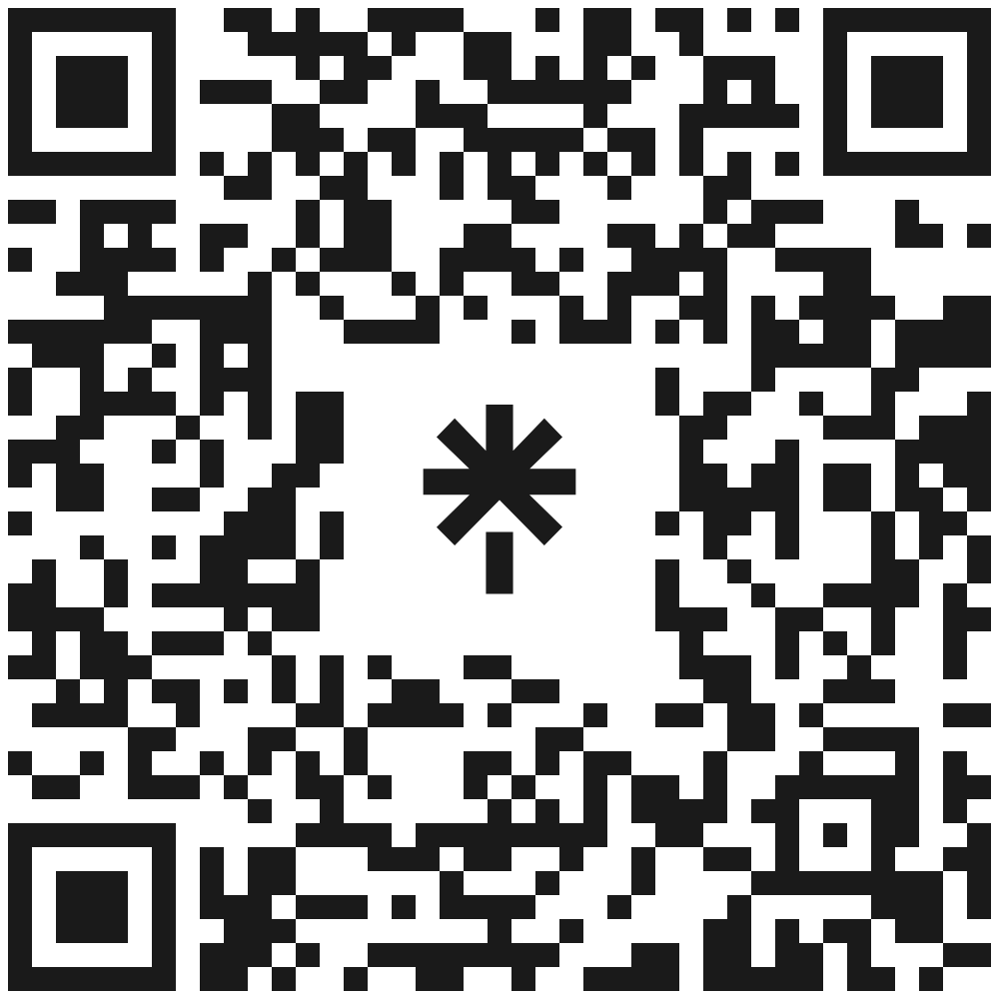
Social Media
Please follow the CarolinaCAP pathway and the CarolinaCrED program on social media and share our posts with your network!

Slide 28
CAROLINA COLLABORATIVE FOR ALTERNATIVE PREPARATION (CarolinaCAP)
AN INNOVATIVE MODEL FOR COLLABORATION IN TEACHER PREPARATION
carolinacap.org

