Slide 1
A Solution for
Teacher Retention
in South Carolina

Slide 2
Facing the Issues
Teacher Shortage
The school year opened with well over 1,000 classrooms without a teacher
~ 50% of new teachers leave their position within the first five years (NCTAF)
Especially higher rates of turnover in hard-to-staff regions of SC (SC-TEACHER)
The average cost ranges from $18,000 to $22,000 to replace a teacher
Teacher turnover negatively impacts student learning and school culture
Retention as the Solution
While recruitment and preparation are vital, teacher retention must be a key factor in solving the teacher shortage in SC.
Notes:
“The teacher turnover issue impacts education on national, state, and local levels. At the beginning of the 21st century, on a national level, 50% of teachers left the profession within five years creating the need for districts to fill vacancies (Gonzalez, Brown & Slate, 2008; Greiner & Smith, 2006; Heller, 2004; Ingersoll, 2002, 2003; Kaff, 2004; National Commission on Teaching and America’s Future, 2003). Ingersoll (2001) found a third of teachers leave within the first three years and nearly half leave after five years.” (https://files.eric.ed.gov/fulltext/EJ1122591.pdf )
From National Commission on Teaching and America’s Future (NCTAF):
Nearly 50 percent of new teachers leave the profession within their first five years.
Students who have highly effective teachers three years in a row score as much as 50 percentile points higher on achievement tests than those who have infective teachers for three years in a row.
Over 40 years of research show that teachers do not have a significant impact on student achievement before their third year
CERRA’s SUPPLY & DEMAND REPORT, All4SC Report and SC-TEACHER data show crisis is not dissipating, but worsening
It has become abundantly clear that we simply cannot recruit our way out of this crisis.

Slide 3
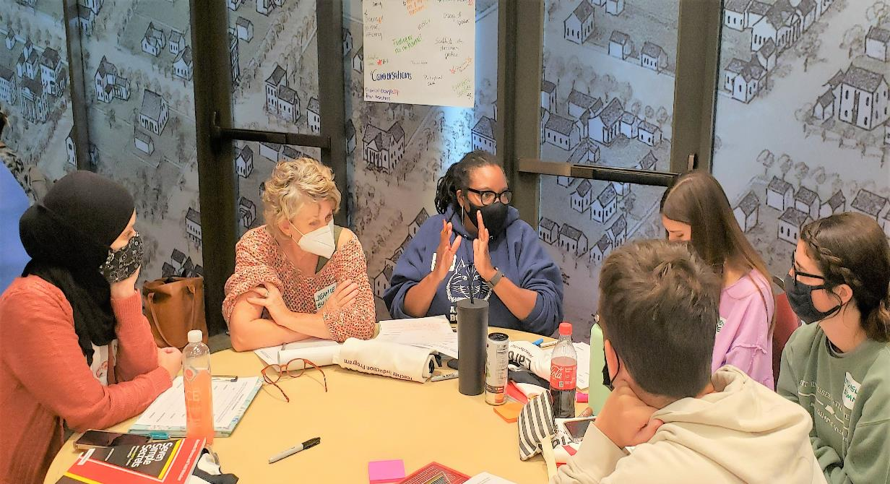
Our Response to the Crisis: Carolina Teacher Induction Program

Slide 4
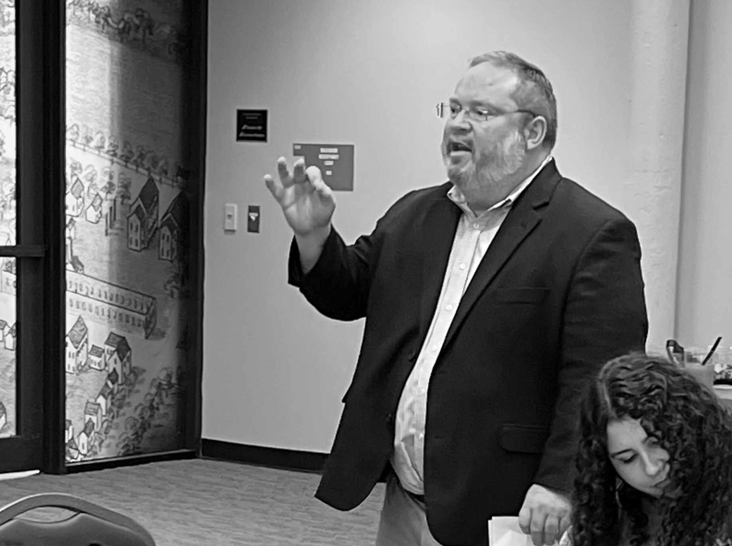
Empowering teachers with the perseverance needed to thrive in a demanding and ever-changing profession by:
growing teachers’ comprehensive capacity and self-efficacy as a means of increasing their resilience
helping teachers navigate and balance the demands of the job
guiding teachers in the development of tools required to meet the increasingly complex needs of schools and students
Notes:
CarolinaTIP is the nation’s first-of-its-kind university-based induction program (OSU is currently building a program based on the CarolinaTIP model)
CarolinaTIP positively impacts teacher retention by remaining teacher focused and focused on the whole teacher

Slide 5
Targeted Teacher Sessions
Teacher Community (External)
Teacher-Focused Coaching/Support
RESPONSIVE SUPPORT | GOALS-BASED COACHING | LEADERSHIP DEVELOPMENT
Notes:
The program is designed to directly address and meet the needs of novice teachers
CarolinaTIP provides
3 years of in-service support for new teachers
A supplemental layer of support in partner districts (does not supplant SC induction requirements or vital district and school-based support)
And provides transferable and universal support which enables the program to serve non-USC grads and work for any content teacher at any level

Slide 6
The CarolinaTIP Approach
Reaching & Teaching
All Students
Classroom Management
Responsive Support
Growing with Intention
Teacher Identity
Responsive Support
Developing as a Leader
Leadership Skills
Responsive Support
1
2
3
RESPONSIVE SUPPORT | GOALS-BASED COACHING | LEADERSHIP DEVELOPMENT
Notes:
Our three-year program is designed to meet the evolving needs of new teachers
Focus for each year strategically targets identified precursors to teachers leaving the profession
Coaching methods compound and evolve to meet the focus of each year in the program

Slide 7
CarolinaTIP: A proven solution for teacher retention in South Carolina
Program Development & Evaluation
Notes:
Robust program evaluation from the Research Evaluation and Measurement Center

Slide 8
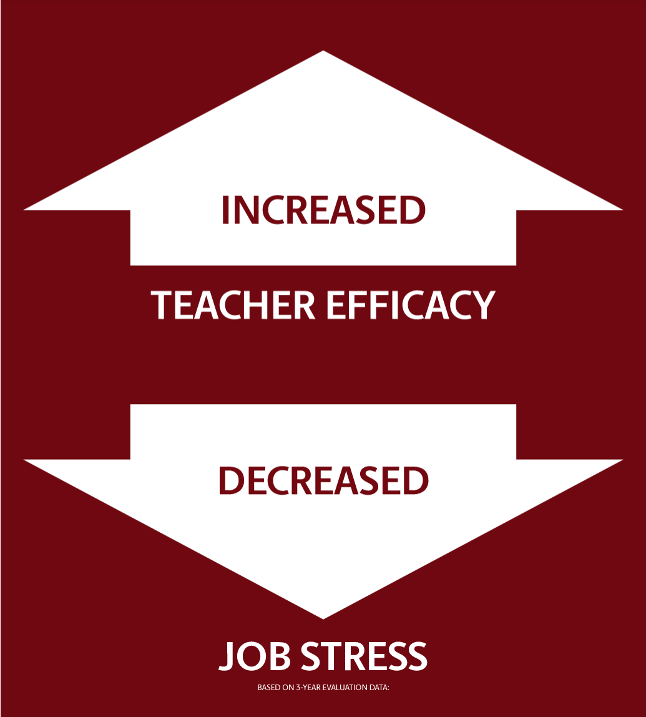
Data Outcome Highlights
Program Evaluators hear from participating teachers that the most valuable aspects of the program are:
CarolinaTIP is external. The coaching and teacher sessions provide a safe place to navigate challenges and receive individually responsive support.
CarolinaTIP is teacher-focused. The program is dedicated to meeting their needs which enables them to feel more effective with their students in the classroom.
Notes:
Over 5 years of data validating program effectiveness
The overwhelming majority of teachers report increased self-efficacy, increased job satisfaction, and decreased job stress as a result of participating in CarolinaTIP (annual evaluation reports 2017-2022)
This is significant when we consider the growing frequency and impact of job-related emotional distress (page 4 table 1 in the 2022 report on The Future of South Carolina's Teaching Profession *data from SC-TEACHER
We also know that a lack of teacher self-efficacy is a leading precursor to teachers leaving the profession
**Zee & Koomen, 2016 “Research has found several indicators a novice teacher is likely to leave the profession, including struggles with classroom management, difficulties managing the stress and resulting burnout that often come with teaching, navigating the demands of the job, and a general lack of self-efficacy.”

Slide 9
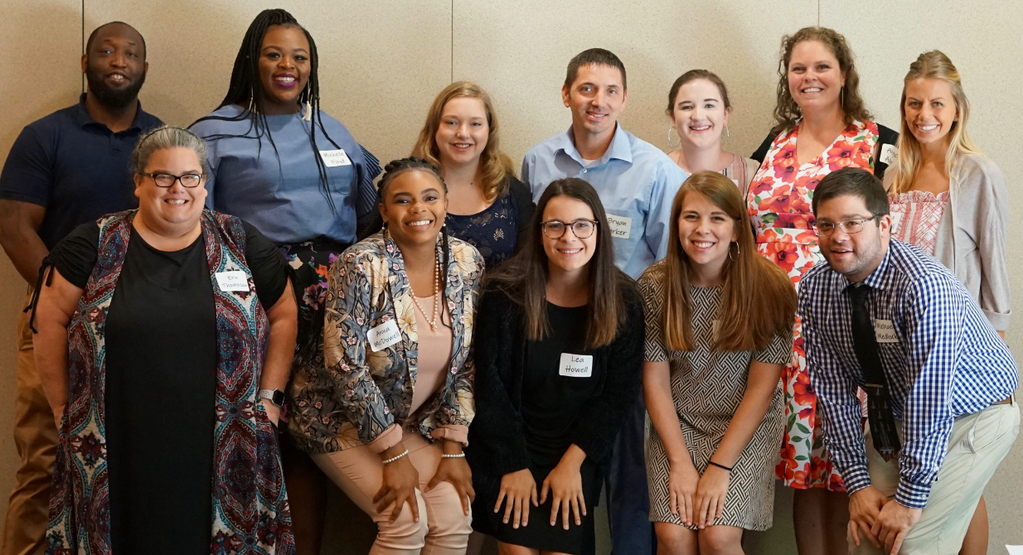
>90%
Support received from CarolinaTIP was one of the strongest positive influences on their overall job satisfaction due to the one-on-one support provided by the Carolina Coach.
TEACHER RETENTION IN THE PROFESSION
Overall Average Yearly Retention Rate

Slide 10
Emerging data suggest CarolinaTIP helps districts retain a difference of +11.7% of their induction classes over a three-year period. At the average cost of $20,000 to replace a teacher, retaining 50 teachers results in future cost savings of $1,000,000 per year. The compounding fiscal impact of prioritizing teacher retention has the capacity to transform teaching and learning throughout districts in South Carolina.
+11.7%
DIFFERENCE IN TEACHER RETENTION
IN PARTICIPATING DISTRICTS
Over the Average District Retention Rate of Induction Teachers
Notes:
Leads me to wonder, what kind of impact could these potential savings have on teaching and learning in SC?

Slide 11
CarolinaTIP Beyond the Numbers
“The CarolinaTIP program is such a powerful solution to the alarming rate that we are losing teachers in the profession. Teaching is not for the faint of heart, and [my coach] has been an answer to my prayers. [My coach’s] joy, passion, transparency, and love of teaching inspire me to keep fighting and keep teaching. [My coach] reminds me of the love I found in this profession and has helped my see the big picture. I can’t drown with a life preserver like CarolinaTIP.”
-CarolinaTIP Teacher
Notes:
With over five years of collaborative program development and demonstrated efficacy, and given the persistent and increasing challenges of teacher retention in SC, it is time to expand and utilize an award-winning program that has the proven ability to significantly impact teacher retention in our state

Slide 12
CarolinaTIP Beyond Retention
“CarolinaTIP is without a doubt a selling point for recruiting high quality, early career talent to our school community. Over the past 5 years, teacher candidates have sought out our school as a place to begin their career. This is due to CarolinaTIP being an opportunity for them to start their career on the right foot. In looking at the challenges and rewards through the lens of an induction teacher, CarolinaTIP serves as a safe space for early career teaching through personalized support, development, and encouragement. As a school leader, it is an invaluable resource to promote the development of teachers, our community's most valuable resource, and the sustainability of our profession.”
Principal Megan Carrero
Fulmer Middle School, Lexington School District Two
Notes:
As word spreads, teachers are intentionally seeking out CarolinaTIP schools in order to take advantage of the added layer of support
This suggests that what we designed as a retention program is now demonstrating strong potential as recruitment tool which begs the question:
As we look to resolve this crisis, how can leaders in education capitalize on the proven impact of CarolinaTIP to not only retain, but recruit, teachers in SC?
As CarolinaTIP positively impacts teaching and learning, one retained teacher at a time, the true beneficiaries will be the districts, schools, and students we ultimately serve.

Slide 13
“TIP has changed my heart about teaching. I was at my breaking point and was almost ready to give up, but now I know I have support from someone who isn’t looking at me in an administrative way. I know I have someone who has my back and genuinely cares about me past the classroom. It has made me more confident in my teaching. It has made me realize I am doing exactly what I need to be doing. It honestly has made me a better teacher with more support than I ever expected to have.”
-CarolinaTIP Teacher

Slide 14
CarolinaTIP
Leadership Team
Leadership Team
From left to right:
Morgan Lee
Lead Development Coach
LaKeisha Lawrence
Development Coach
Nicole Skeen
Director
Angela Adams
University Induction Coordinator

